Slide 1
Requirements
Name of Lecturer
Institution of Lecturer
00
00
0000

Slide 2
Content Overview
Motivation
Organisational Models
Education
Social Skills and characteristics of social farmers
The organisation of a social farm
Farm Environment
Working, hygienic and safety measures
Work management

Slide 3
Motivation
Why do farmers start a social farm?
Notes:
So why do farmers start a social farm? The Reasons vary from person to person, however there are some quite common motives.

Slide 4
Motivation
Potential Motivation to enter Social Farming:
Personal Involvement & Experience
Use of skills / professional qualification
Farm Development/ Diversification
The offer of innovative nature-based services in a social facility
…
Notes:
Personal Involvement & Experience
Some come into contact with a particular target group through caring for a family member or similar. From these experiences, the desire to expand the care can grow.
Use of skills / professional qualification
Many employees associate their entry into social farming with the opportunity to use their professional qualifications in the social sector;
Farm Development
A high income expectation is rareks the reason to enter social farming. For some farmers, however, it represents an opportunity to consciously oppose the intensification of agriculture and to incorporate their conviction of doing something social into the farm.
The offer of innovative nature-based services in a social facility
When it touches residential year-round care social farming arises as a new offer in their lives. It is different care provided than in a regular social facility. A close idea linked to this is to bring people, nature and animals in harmony with each other because of the proven benefits of nature to humankind.

Slide 5
Forms of offer
What are the organizational models in social farming?

Slide 6
Organisational Models
Agricultural Model
An agricultural enterprise offers social services as an additional entrepreneurial activity.
Comparable to activities in rural tourism or direct marketing, for example, the service offer is integrated into the agricultural enterprise as a "side business" without its own legal form.
Farm
Social Services
Notes:
First, social farming can develop from a farm that already exists and is looking for further diversification opportunities.
In other words, an agricultural enterprise offers social services as an additional entrepreneurial activity. Comparable to activities in rural tourism or direct marketing, for example, the service offer is integrated into the agricultural enterprise as a "side business" without its own legal form. The farmer is responsible for providing the service and acquiring clients. Apart from the possibly necessary contacts to cost units, there are no direct cooperation partners.

Slide 7
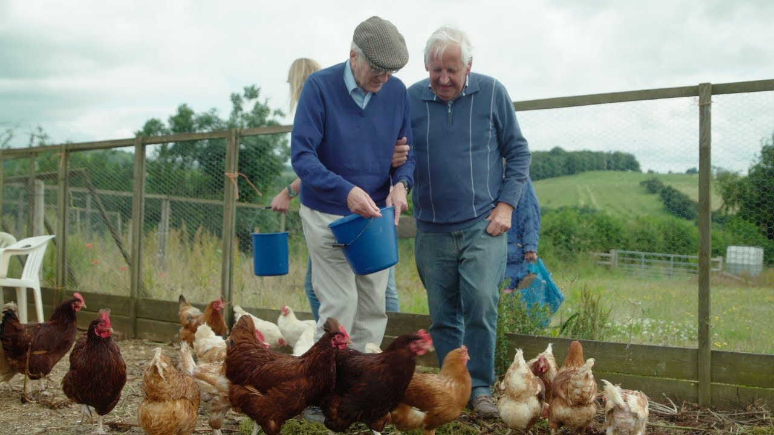
Organisational Models
Examples for the agricultural model
Short-term support for groups, e.g. day trips for residents of retirement homes, groups from a sheltered workshop

Slide 8
Organisational Models
The agricultural model accounts for only a small part of social farming. There are several reasons for this, such as:
- Proof of minimum qualifications in the social sector,
- Professional management to avoid competition between agriculture and social services,
- More frequently changing clients and target groups, usually no continuous workload,
- High degree of personal flexibility required,
- No fixed cooperation with a social service provider, therefore high administrative effort.

Slide 9
Organisational Models
Social Model
Social Services
Farm
The starting point is professional providers in the care, nursing or therapy sector who, as independent entrepreneurs, want to combine their services with the advantages of an agricultural environment.
Notes:
While it could previously be assumed that social service offerings would develop out of a farm or household, a second strategy now seems to be gaining a foothold in practice. It has its origins in existing social services, for the implementation of which an agricultural enterprise is sought. The starting point is professional providers in the care, nursing or therapy sector who, as independent entrepreneurs, want to combine their services with the advantages of an agricultural environment. In such cases, the focus is then on the development of this environment, e.g. by setting up animal husbandry, planting gardens, tending orchards and processing the products.
The focus of activity is on the care and therapy of people with different - even high - needs for help: mental or physical disability, developmental disorders of children and young people, vocational preparation after long-term unemployment, etc. Parts of the services are provided in cooperation with the farm, for example by offering part-time employment or integration into fixed farm work structures.

Slide 10
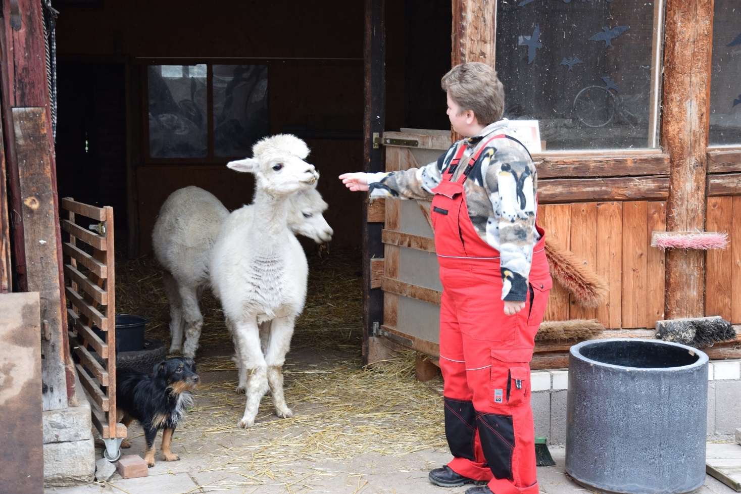
Organisational Models
Examples for the social model
Participants are accommodated in a therapeutic facility (e.g., in an assisted living group) and work on an associated farm.
Inpatient care with therapy (occupational therapy) for people with high support needs

Slide 11
Organisational Models
Cooperative Model
farm
Social services
An agricultural enterprise or its manager and a social institution act jointly as service providers. The range of tasks of the partners can vary.
Social farming
Notes:
An agricultural enterprise or its manager and a social institution act jointly as service providers. The range of tasks of the partners can vary.
In most cases, agriculture provides the appropriate setting for a place of work, housing or therapy. The corresponding social service can be provided by the farmer alone or in cooperation with the social institution: The agricultural partner provides the living space, the catering and the necessary daily care. The social service provider talks to the clients and, if necessary, also with the farmer during regular visits to the farm, in order to tailor the social services as closely as possible to the needs of the people being cared for. The social service provider is also responsible for communication with the cost bearer, the billing of the services and the administrative handling of the offer.

Slide 12
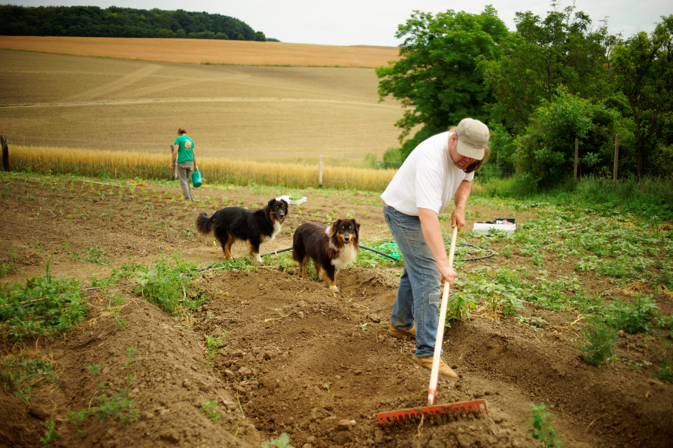
Organisational Models
Examples for the cooperative model
Offer of subsidized workplaces/ external workplaces in cooperation with Sheltered workshops
Therapy offers for small groups or individuals with special needs for help

Slide 13
Education
Do I need a specific education to become a care farmer?
Notes:
Generally spoken a correct basis attitude, sufficiently social skills, affinity and experience
with the target group is more important than having specific diplomas. There are several possibilities to require necessary knowledge and skills.

Slide 14
Education
The combination of social work and agriculture requires a high level of qualification.
In order to instruct and guide the participants in the work, additional professionals from the social sector must be present.
Farmer: work-pedagogical processing of agricultural activities or the knowledge of which activities the participants can be entrusted with according to their needs and abilities.
Courses and trainings for social farming
Notes:
The combination of social work and agriculture requires a high level of qualification.
On a farm that is new to social farming, the staff is most likely to have training in the agricultural field. In order to instruct and guide the participants in the work, additional professionals from the social sector must be present.
Essential areas of knowledge of the farmer that must be taken into account are, for example, the work-pedagogical processing of agricultural activities or the knowledge of which activities the participants can be entrusted with according to their needs and abilities.
Beside the conventional care education and training, there are for example also courses, focussed on starting a social farm and guidance of participants.

Slide 15
Social Skills and characteristics of social farmers
What does it take to work with people?

Slide 16
Social SKills
Empathy
“Humanity and empathy are among the core competencies of the manager in our two operations”
supervisor of persons with medium and heavy intellectual disability
“It is far more important to be empathetic and to be communicative than educated.”
supervisor of Youth
Notes:
Employment in social agriculture requires strongly developed personal skills. With any target group, it is important to be able to empathize. If you for instance look at supervising refugees, it is sometimes difficult to understand their side of the story because supervisors have not often been in situations of war and violence. Directly linked to this is the ability to be open to people and, in the case of refugees, to other cultures and their stories.

Slide 17
Social SKills
Patience
“One of the main competencies that we are good at when managing our clients in the workplace is patience, and patience again.”
Supervisor of people with intellectual disability.
“Otherwise bring much, much love and patience.”
Supervisor of Youth
Notes:
It is important to be patient in working with the target group so people can take their time to learn new things and skills.

Slide 18
Social SKills
Mental resilience and stability
“When they start as a supervisor in child and youth care they are young and not always stable personalities per se. As soon as they meet someone who challenges them and triggers something, they are overwhelmed.”
Supervisor of young people with behavioural problems
“You have to ground yourself and the participants”
Supervisor of people with mental health challenges
Notes:
The employees must be able to handle higher levels of pressure and stress. It is important to be persistent and stable, otherwise, you will soon run into yourself as the respondents indicated.

Slide 19
Social SKills
Authenticity and self-reflection
“Young people often have the feeling that they are stupid. And maybe they are from time to time, but we all are at some point. Then I take away their fear [ed. by showing that I myself not only have the perfect life].”
Supervisor of youth
“I am authentic with all my life experiences, as I stand here, with all my weaknesses and strengths, with all my stories. And I don't mince words. Do you want me to talk to them in some way? That is life as it is lived.”
Supervisor of youth
Notes:
Authenticity is important working with every target group but according to our interviews especially if you are working with youth. As one of the respondents tells:

Slide 20
Social SKills
Open mind
“In any case, you have to be very open to other cultures. And of course you have to understand that there are sometimes conflicts.”
supervisor of refugees
“Open-mindedness is the fundamental thing. Some might have cognitive disabilities but they still have 40 or 50 years on the earth and they can tell when someone genuinely sees them as an equal or doesn’t. You develop trust based on that, the lads will be quite good at reading people, they’ve seen all sides of humanity the good and the bad.”
Supervisor of people with intellectual disability
Notes:
Having an open mind is very important. An open mind toward participants but also toward new ideas and plans. This is related to the flexibility. As one of the social farmer tells

Slide 21
Social SKills
Flexibility
“Flexibility in the sense that I can’t expect something. Every day is different because a person feels different. Therefore I always have to have a plan B. I can’t standardize anything. And what is working at this moment can completely fail the next time.”
Supervisor of people with mental health challenges
Notes:
Respondents who work with people with mental health problems indicate that flexibility is an important characteristic.

Slide 22
The Organisation of a social farm
How do I adjust the buildings and the farmyard in such a way that they are suitable for participants?
Notes:
Now we move a bit away from the people and look at the farm where the social farming will take place. Here again, there are detailed regulations that cannot necessarily be applied across the board to all target groups.

Slide 23
Farm Environment
In most cases, modifications have to be made when starting a new project.
Break and recreation room
Sanitary facilities
Canteen or large-scale catering facilities
Barrier free access
Accommodation
Parking or access to public transportation
Good Infrastructure
Notes:
A farm is not automatically suitable to serve participants. In most cases, modifications have to be made when starting a new project. These adaptations depend on the target group, the type of offer and the number of participants. A suitable break and recreation room as well as sanitary facilities are necessary in every form of offer. With an increasing number of participants, a canteen or similar large-scale catering facilities may be necessary.

Slide 24
Working, hygienic and safety measures
The workplace must be arranged in such a way that the risks of accidents are kept to a minimum.
Introduction to the farm: when and where are the participants allowed on the farm?
Storing hazardous materials properly
Locking up machinery that participants might use without authorization
Protection from adverse weather conditions and high temperatures
Rules for the work with animals (e.g. cleaning and tethering of animals is always carried out from the side where there is minimal risk of being pushed or pressed by the animal)
Notes:
A farm is not automatically suitable to serve participants. In most cases, modifications have to be made when starting a new project. These adaptations depend on the target group, the type of offer and the number of participants. A suitable break and recreation room as well as sanitary facilities are necessary in every form of offer. With an increasing number of participants, a canteen or similar large-scale catering facilities may be necessary.

Slide 25
Work Management
The basic conditions must be right so that participants can learn new things, work independently and perhaps even take responsibility for an area of activity.
Ideally there should be at least part-time one social worker on site to guide the participants.
Decouple the educational work from the agricultural processes.
Activities that enable independent and self-determinded work of the participants.
Notes:
The work oft he participants should be planned conscientiously and with the involvement of all family members and employees. At least one educator or social worker should at least part-times be on site in order to be able to guide the participants with the appropriate profession.
It is advisable to decouple the educational work from the agricultural processes. The social workers are then responsible for the participants, but not for the fact that the agricultural activities themselves are done. The farmers must be aware that there can be delays in the operational process when the participants are on the farm, as their care takes a lot of time. This increases the required work capacities, which must be taken into account in the division of work. Depending on the target group, it is possible that the participants lack the cognitive or physical abilities to operate demanding machines. Technical and extensive activities, such as the cultivation of vegetables and fruits, are therefore advantageous for the participants and the operational process.
As with most socially oriented farms, there is a conflict of interest between social and agricultural tasks. Due to the relatively hard-working and adaptive client group of people with addictions, the limits do not seem to be as great as in companies that integrate people with severe disabilities.
When planning the work, repetition, breaks and rhythms, steps that can be learned in steps and cycles that structure the work in a comprehensible manner for the participants are essential. The aim should be to enable the most independent and self-determined activity possible. This should be able to be carried out at the individual pace of the participants and with little external pressure. The work should make successes visible and tangible for those carrying out the work and should be rewarded with praise and recognition by the supervising care farmer.

Slide 26
Example
Requirements for a social farm that works with people in recovery from addiction.

Slide 27
Example: P. in Recovery from Addiction
Section | Requirements
Organisational model | Preferably a cooperative or social model, as the amount of supervision is quite high and participants are likely to need therapeutic guidance.
Social Skills | - Willingness and ability for the necessary cooperation with the social institution. - A positive attitude towards people with addiction must be present. - Empathy and patience in the integration into the work routine on the farm are required. - no addiction problems of their own.

Slide 28
Example: P. in Recovery from Addiction
Section | Requirements
Farm Environment & Savety | Preferantial farms with animal husbandry and a not too high level of mechanization Ensure the safety of workspace Participants occupy their own room and use other rooms communally
Work management | The range of work should be varied Sufficient work capacity must be available for the additional time required to guide people with addictive disorders. The maintenance of day-to-day operations should not be dependent on work performance.

Slide 29
Assignment
What are the Requirements for a social farm for the Elderly?

Slide 30
Assignment: The Elderly
Section | Requirements
Organisational model
Social Skills
Farm Environment & Savety
Work management

Slide 31
Assignment: The Elderly
Section | Requirements
Organisational model | Cooperation with outpatient care services
Social Skills | Affinity for dealing with older people Basic social and nursing understanding for elderly people in need of help
Farm Environment & Savety | Good infrastructure (doctors, pharmacy, hairdresser, shopping facilities...) if necessary compensate by driving services Clarify care and nursing care when reaching care levels
Work management | With exclusive rental little labor capacity necessary The Elderly should be allowed to perform routine farm tasks to give them employment if they want to

Slide 32
thank you for your attention
Name of Lecturer
Institution of Lecturer
name@xyz.com

Slide 33
Farming with Refugees and forced displaced people - Agriculture as a path of inclusion © 2023 by SoFarTEAM is licensed under CC BY-NC 4.0.
To view a copy of this license, visit http://creativecommons.org/licenses/by-nc/4.0/
The slides were created by Lisa Essich
Contact:
University of Applied Science Neubrandenburg
Brodaer Str. 2
17033 Neubrandenburg, Germany
essich@hs-nb.de

