Slide 1
SOCIAL FARMING THEORIES
Name of Lecturer
Institution of Lecturer
00
00
0000

Slide 2
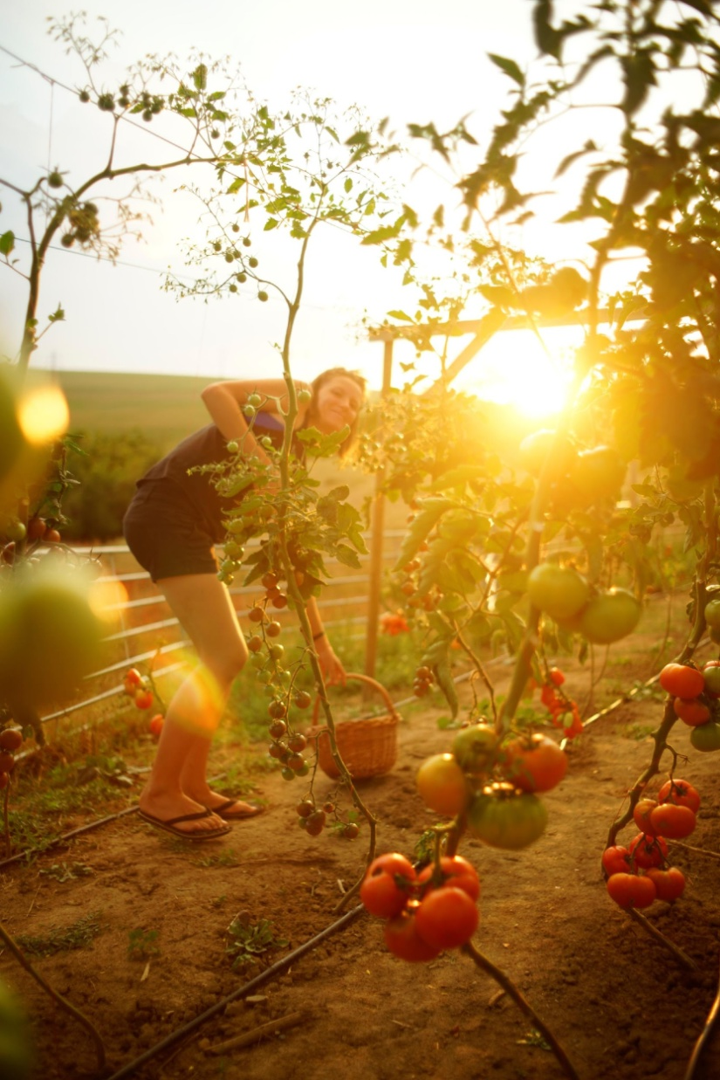
TABLE OF CONTENTS
Connectedness
Contact with nature
Benefits of exercise
Occupation as a therapeutic element
Social work theories in social farming
Vernunft & Verstand

Slide 3
How to define agriculture?

Slide 4
ABOUT AGRICULTURE
Agriculture is part of civilization.
It fulfills needs: food, clothing, protection of the landscape and nature, protection of historical wealth, preservation of biodiversity, etc.
Agriculture is a science, an art, a profession, a source of raw materials for further processing.
It is part of the use of water resources, soil, ensures nutrition, affects health, consumption of food and feed, part of tourism. It interweaves economic, social, political, environmental and cultural systems.

Slide 5
How to define social work?

Slide 6
GLOBAL DEFINITION OF SOCIAL WORK
“Social work is a practice-based profession and an academic discipline that promotes social change and development, social cohesion, and the empowerment and liberation of people. Principles of social justice, human rights, collective responsibility and respect for diversities are central to social work. Underpinned by theories of social work, social sciences, humanities and indigenous knowledges, social work engages people and structures to address life challenges and enhance wellbeing.”
Approved by the IFSW General Meeting and the IASSW General Assembly in July 2014, Global Definition of Social Work – International Federation of Social Workers (ifsw.org)

Slide 7
SOCIAL FARMING DEFINITION
In 2012 the European Economic and Social Committee framed an Opinion on social farming.
The EESC defines Social Farming in the following way:
Social Farming adopts a multifunctional view of agriculture that combines farming with social services/health care at local level. It can help to improve social and environmental awareness, in accordance with social and solidarity principles.
Even though social farming comprises a very wide range of activities, they always have two elements in common:
a) the activities take place on a farm or market garden and
b) they are designed for people who – either temporarily or permanently – have specific needs, including educational needs.

Slide 8
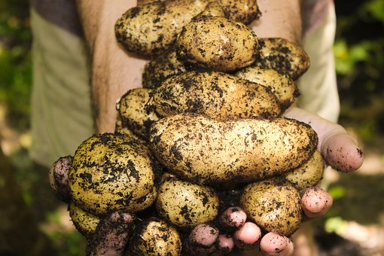
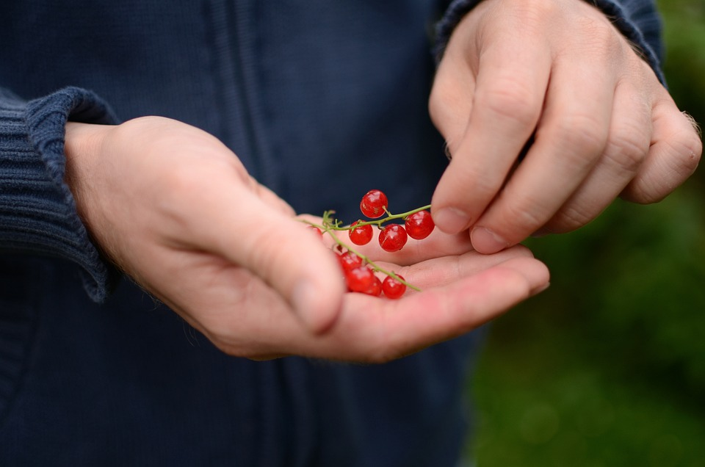
BASIC CONCEPTS OF HUMAN-NATURE INTERACTION
Photos: www.pixabay.com/

Slide 9
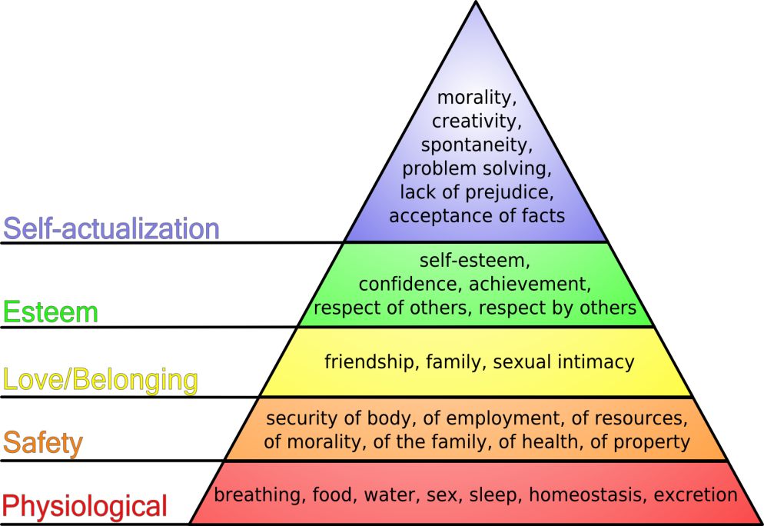
CONNECTEDNESS AND BELONGING
Need to feel connected with other people
Physical aspects (food, shelter, safety, health care and protection)
Personal fulfilment (education, rest, values, aesthetics, religion, achievement)
Emotional needs (sense of belonging, mutual care, community)
Self-concept (self-confidence, self-esteem, personal identity) (Barker, 2003)
Celebration and mourning, integrity, interdependence, play and spiritual sharing (Rosenberg, 2012)
Maslow's hierarchy of needs | Psychology Wiki | Fandom
Notes:
Draw a picture with a place you would like to stay the most. You will later test whether the students identify the common elements of water, food, shelter and security according to the Savannah hypothesis by Orians (1980).

Slide 10
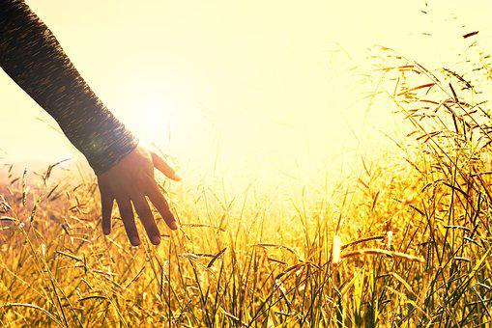
CONNECTEDNESS AND BELONGING
Social integration and social cohesion
Influence on psychological well-being
Being socially connected is the human brain‘s lifelong mission, that has evolved over millions of years, resulting in major differences in the brain that distinguish us from our ancestors (Lieberman, 2013)
Disconnection from the normal, required, basic human need of connection thourgh touch and touching. Suicidal youngsetrs have lower tactile sensitivity and responsiveness and lower emotional investment in the body. (Orbach, 2003)
Photos: pixabay.com

Slide 11
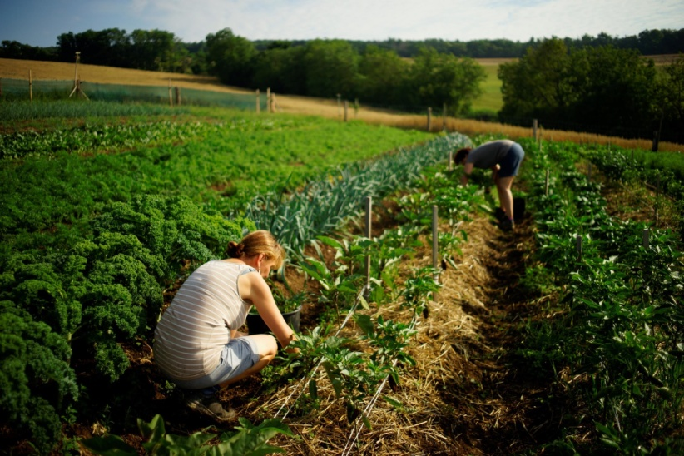
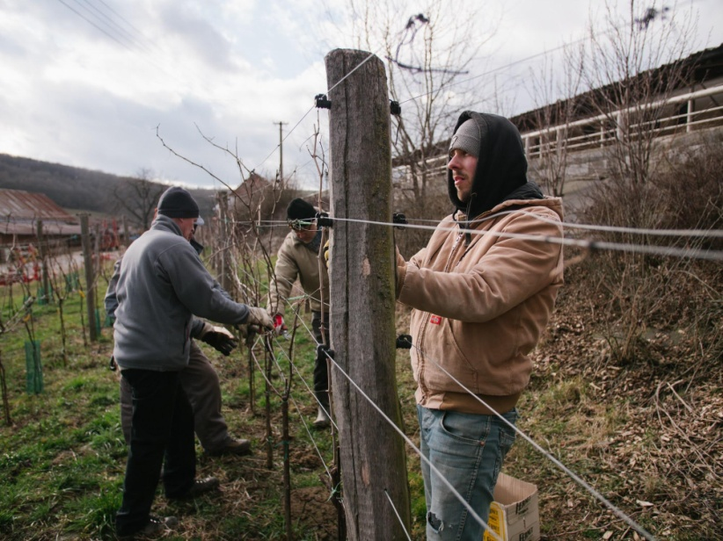
CONNECTEDNESS AND BELONGING
Notion of feeling connected to the world or universe
Ontological exigence (Marcel, 1948)
Innate for some level of coherence in the cosmos
Experiencing a sense of knowing one‘s place in the world
One has a place and purpose (Cutcliffe, Stevenson, 2007)
Place identity theory (Proshansky et al., 1983)
Concept of attachment to a specific place
Identity formation as a social construct dependent on community, shared norms, historical determinism, culture, language, social class, landscape
Photos: Social farm Jasan.
Author: Martin Matěj

Slide 12
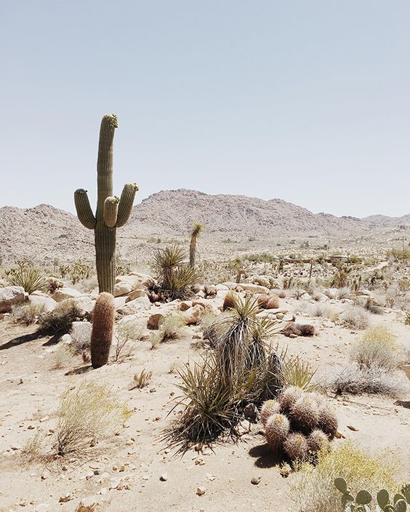
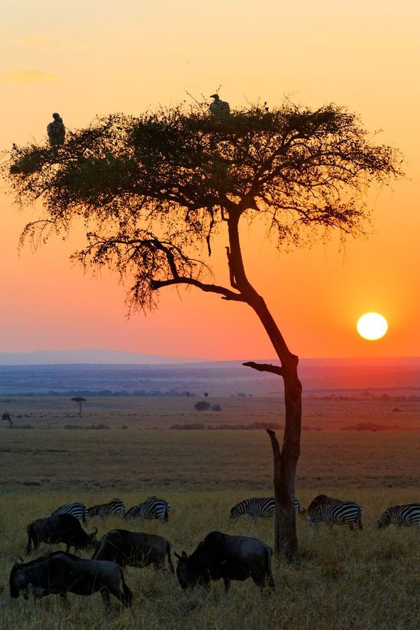
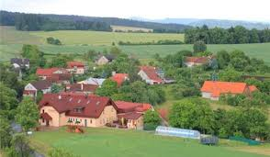
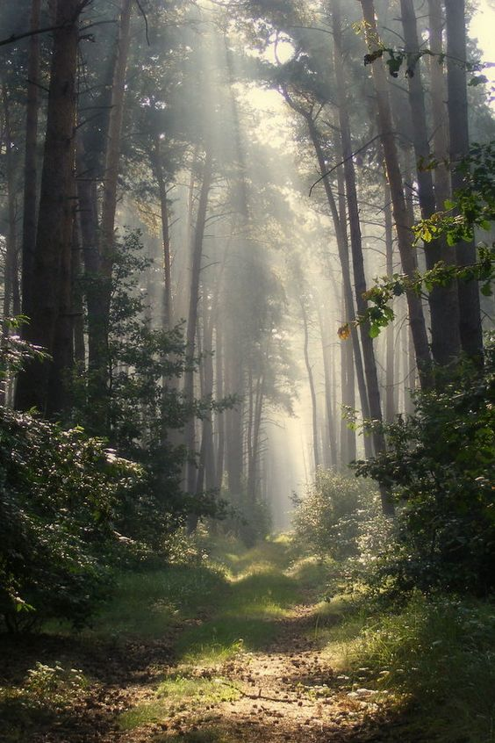
Photos: pixabay.com
Notes:
What is the most prefered place to the students? (Place identity theory, Proshansky et al., 1983)

Slide 13
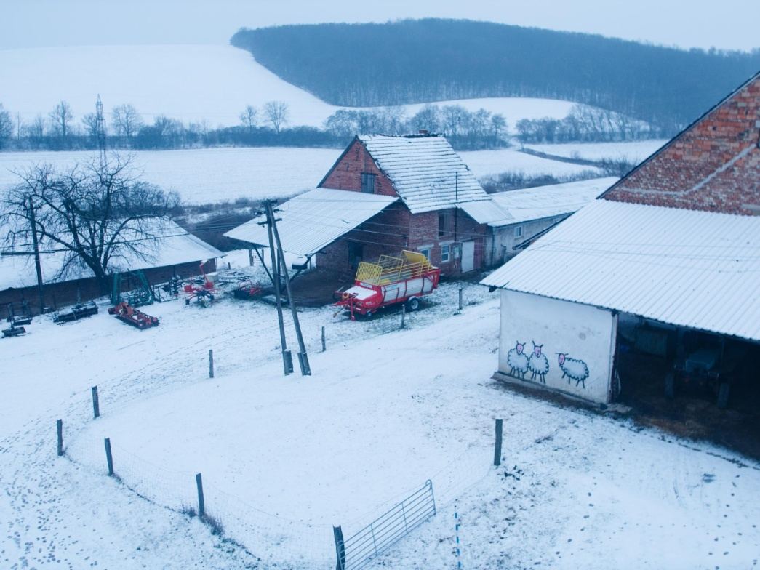
HABITAT THEORY (GORDON H. ORIANS, 1980)
Evolutionary psychology, savannas-type landscape (African savannah, Charles Darwin‘s theory in his The Origin of Species, 1859)
„Natural selection should have favoured individuals who were motivated to exprole and settle in environments likely to afford the necessities of life but to avoid environments with poorer resources of posing higher risks“ (Orians & Heerwagen, 1992)
Landscape preferences (parks, grasslands, trees) – positive emotions
Clarity - sense of security
Food security
Water
Shelter
Photo: Social farm Jasan.
Author: Martin Matěj
Notes:
Gordon H. Orians, evolutionary biologist at the University of Washington Colege of Arts & Sciences. Savanna landscapes provide opportunities of openness and seclusion and may provide a plausible explanation of the importance fo the pastoral landscape. Preference of municipal parks of today.

Slide 14
CONTACT WITH NATURE
Improve psychological health and well-being
Reducing stress and enhancing a person‘s mood
Exposure and the subsequent contact with green space can have powerful positive effects on a person‘s mental health (Beyer et al., 2014; Pretty, 2004)
Viewing nature; being in the presence of nature; active participation and involvement in nature
„Higher levels of neighborhood green space correspond to better mental health outcomes, when controlling for a wide range of confounding factors. The assiciations between green space and mental health are significant and sizeable and persist with different measurement techniques. Furthermore, the estimated effect of environmental green space is similar in magnitude to that of other well-known and studied contributors to symptomology for depression, anxiety and stress“ (Beyer et al., 2014: 3468 in Ctucliffe and Travale, 2016)

Slide 15
PSYCHO-EVOLUTIONARY THEORY, AND THEORY OF SUPPORTIVE DESIGN, ROGER ULRICH, 1983, 1991
Emotional (affective) responses to landscapes occure before cognitive information processing
The positive emotions and physiological effects have survival benefits
Testing participant‘s feeling before and after viewing slides of urban (negative feelings – less friendly, less elated, less attentive) and natural scenes (the opposite feelings)
Scenes with trees and other vegetation showed reduce feeling of fear and increase positive feeligs
Theory of supportive design (1991): patient stress will be reduced if the hospitals environment fosters perceptions of control (views of outdoor setting: vegetation and water), positive distraction and social support
Early classical study (1984): recovery of patients in a hospital comparting those whose rooms viewed a blank wall with those who could see trees.
Those who viewed the trees had shorter stays in hospital (7,96 days vs 8,70 days, took fewer analgesics and receive fewer negative evaluative comments in norse‘s notes (3,96 vs 1,13)
Notes:
Roger Ulrich, Emeritus Professor, College of Architecture at Texas A a M University and visiting Professor of Architecture at Chalmers University of Technology in Sweden.

Slide 16
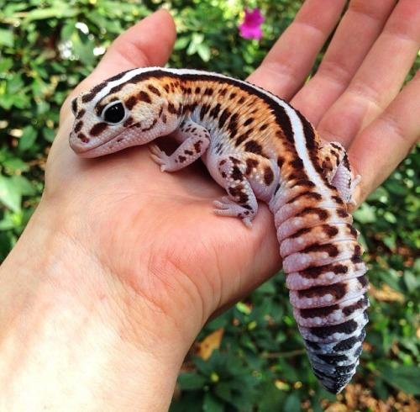
BIOPHILIA HYPOTHESIS, EDWARD O. WILSON, 1984
Biophilia as an innate affection for living organisms
Complex rules of behavior learned and genetically encoded (not instinct)
Affection and phobias, positive and negative emotions and reactions
If one detaches from nature, biophilic rules are not replaced – thus threat of loss of care for nature (life sustainability)
According to the UN, by 2050, up to 66% of people will live in cities
Photo: pixabay.com
Notes:
Edward Osborne Wilson (June 10, 1929 – December 26, 2021) was an American biologist, naturalist, and writer. His specialty was myrmecology, the study of ants. Wilson has been called "the father of sociobiology" and "the father of biodiversity" for his environmental advocacy, and his secular-humanist and deist ideas pertaining to religious and ethical matters. Among his contributions to ecological theory is the theory of island biogeography (developed in collaboration with the mathematical ecologist Robert MacArthur), which served as the foundation of the field of conservation area design, as well as the unified neutral theory of biodiversity of Stephen P. Hubbell.
Wilson was the Pellegrino University Research Professor Emeritus in Entomology for the Department of Organismic and Evolutionary Biology at Harvard University, a lecturer at Duke University,^{[8]} and a fellow of the Committee for Skeptical Inquiry. (Wikipedia.org)

Slide 17
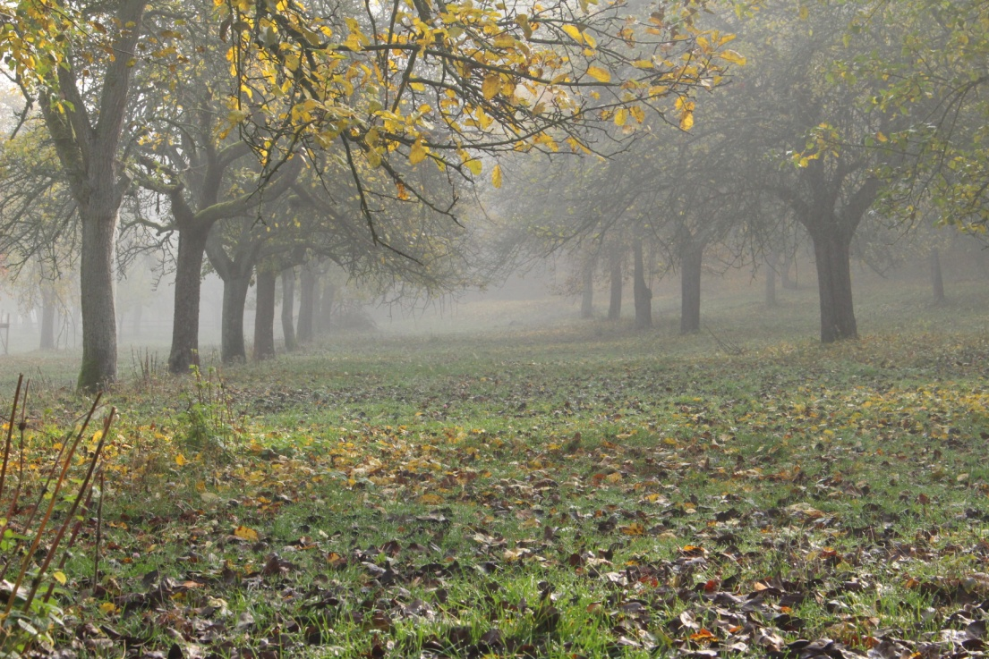
ATTENTION RESTORATION THEORY, STEPHEN AND RACHEL KAPLAN, 1983
Involuntary attention x focused attention
Focused attention consumes energy – mental fatigue
Nature as a medium of regeneration
Observation without other energy sources
Fascination (mild x severe)
Detachment (space, time)
Width (complex impression)
Compability (with the human needs)
Photo: Autumn orchard, Biostatek farmyard (CZ).
Author: Vojtěch Veselý
Notes:
Rachel and Stephen Kaplan are renowned in the field of environmental psychology. Professors of psychology at the University of Michigan, the Kaplans are known for their research on the effect of nature on people’s relationships and health. Their work on “restorative environments” and Attention Restoration Theory has had a tremendous impact on how landscape and design professionals and others view humanities relationship with nature. The Kaplans got involved in studying the effects of nature on people back in the 1970’s with a US Forest Service grant to evaluate a challenge program in Michigan’s wilderness. This introduction went on to influence a generations worth of environmental psychologists and designers.
The Kaplans have found that too much focused attention on anything can lead to mental fatigue and such fatigues remedy is found in exposure to nature. In order for nature to best work its relaxing effect it is preferable for a place to have high fascination value. An environment that automatically pulls the viewer into it is most beneficial. The Kaplans research has found that office workers with a view of nature were happier and healthier at work. Exposure to natural environments of the most mundane sort has proven to lift people’s moods and enhance their ability to mentally focus. (Rachel and Stephen Kaplan | Psychology Wiki | Fandom, 2022-10-14)

Slide 18
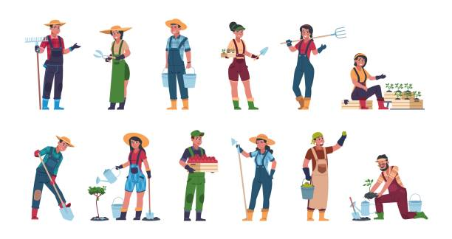
BENEFITS OF EXERCISE AND OCCUPATION
Engaging in physical exercise has a therapeutic effect for people experiencing depression or anxiety
„Engaging in 30 minutes of treadmill walking for ten consecutive days produced clinically and statistically significant reductions in depression rating scores.“ (Dimeo et al., 2001 in Cutliffe & Travale, 2016: 140)
Occupation creates structure and organises time, it brings meaning to life (needs to be personalised)
Employment is positively correlated with improved psychological and physical health Significant increase of quality of life or self-esteem.
Work and employment seems to foster a sense of belonging (Sempik et al., 2010)
Photo: pixabay.com
Notes:
William Rush Dunton, 1919, Habit Training initiated at Johns Hopkins hospital in the early twentieth century. The lack of structure and balance in the lives of clients with mental health problems, meant that these individuals would benefit from occupational activities such as work, rest and play. Goal-directed activities should be used to help individuals learn new skills, become more productive, and experience the therapeutic benefits of a balanced daily schedule.

Slide 19
HUMANISTIC AND EXISTENTIAL THEORIES
Client-oriented approach (C.R. Rogers)
Congruence and genuineness in the relations with the participant
The worker should act in accordance with his or her experience and as a real person, sharing the relationshop
Non-judgemental, non-directive, active listening, authentic friendship
Logotherapy and existential analysis (V.E. Frankl)
Human will to meaning
Meaning is found through the realisation of values:
Creative values
Experiential
Attitudinal
Notes:
Carl Ransom Rogers (January 8, 1902 – February 4, 1987) was an American psychologist and among the founders of the humanistic approach (and client-centered approach) in psychology. Carl Rogers. (2022, October 2). In Wikipedia. https://en.wikipedia.org/wiki/Carl_Rogers

Slide 20
VALIDATION THERAPY, NAOMI FEIL (1992)
An alternative approach that is used when working with disoriented old-old people
Disoriented people: old age dementia, disturbed memory, impaired thinking and sort-term memory) – emotional and inadequate reactions to their current state (crying, despair, agression)
The role of validation is to confirm to them that their feelings are real that I, as a caring person, acknowledge them
Therapy based on several fundamental principles, such as the things from the present (colours, sounds, smells, tastes) can trigger memories from the past (Procházková, 2012). Clients then return to the past, where they were needed and productive persons (Pokorná, Sukupová, 2014)
Notes:
Americal gerontologist born in 1932 in Munich. Validation Therapy as alternative to traditional methods of working with the severely disoriented aged people. She grew up in the Mentefiore Home for the Aged in Cleveland. Her mother was the head of the Social Service Department and her father was the administrator.

Slide 21
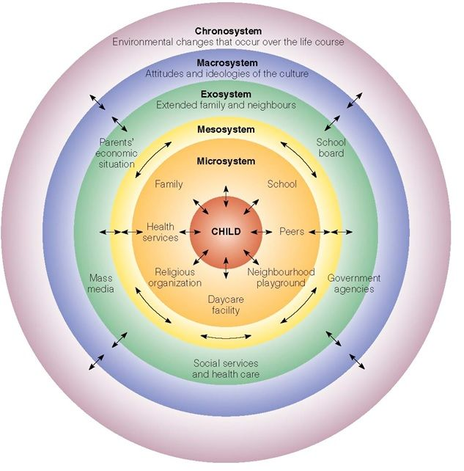
MAN IN THE ENVIRONMENT – THE SOCIAL-ECOLOGICAL MODEL
Mutual and constant interaction between the individual and its environment – interconnectedness and interdependence of the five basic systems influencing each other (Bronfenbrenner, 1977)
Microsystem
Mesosystem
Macrosystem
Exosystem
Chronosystem
Notes:
Urie Bronfenbrenner, American psychologist focusing on child development. Laboratory features of research are not characteristic of environments that children actually live and develop in.

Slide 22
VERNUNFT & VERSTAND – IDEAS OF IMMANUEL KANT AS UNDERSTOOD BY R. W. EMERSON
Reason = Vernunft
true, deep thinking
According to R. W. Emerson intuition sees beyond nature – into the spiritual realm where the truth and true moral principles arise: „the spiritual measure of inspiration is the depth of the thought“ (Emerson, 1950, p. 90)
That calls for constant immediate presence – constant tuning – inquiring manner approach
Understanding = Verstand
based on our sense
rational, everyday thinking
Notes:
According to Immanuel Kant and many of his followers – in this sense including Ralph Waldo Emerson – think that there are two ways how anybody can approach understanding of the world, especially understanding to the nature and trhough the nature. Emerson emphasises the role of intuition and the need of full presence if anybody wishes to grasp the whole, in other words what is going on beyond the obvious. This helps when we attempt to perceive deeply farming/natue environment as the space and time where we can work with people.

Slide 23
REASON (VERNUNFT)
Contemplates the true essence of the world – it contemplates or sees thanks to the heart, thanks to intuition into the spiritual realm. That is why education should set the heart in flame.
Listening to silence, tuning yourself in – it uncovers the holistic nature of (wo)man
To be able to „contemplate“ you need free time (Freizeit in Kant´s words)
Perceiving the farm as something deeply connected to nature, supporting its sustainability
Notes:
Reason (Vernunft) is a way of perceiving/thinking/understanding the world – the deep way of understanding the world, being.

Slide 24
UNDERSTANDING (VERSTAND)
Splits the reality into separate details and thus makes it fixed and stable – that makes it almost impossible to see the connections
Perceiving the farm as means of wealth, power, etc. = exploiting & short-term thinking
Notes:
Understanding = the usual and also the shallow way how to perceive world.

Slide 25
Farming environment - being fully present
Our goal – is to attempt to see the whole and yet know that it is impossible. We have to transcend ourselves towards uncertainty … we see the whole, and yet we cannot grasp it. We became aware of our finiteness and limits, but we already possess the hope – the knowledge that we have „seen“ the whole and that builds our self-reliance.
Transcending our stereotypes and issues we deal with automatically into uncertainty makes us fully present and aware of the present moment.
Notes:
The goal is to be fully present for only then we may act in accord with the nature. We have to use our intuition (reason) to see the whole and then act as farmers, social workers etc. The uncertainty it brings may become the strength. The truly solid and firm is only what is trembling/shaking or uncertain.

Slide 26
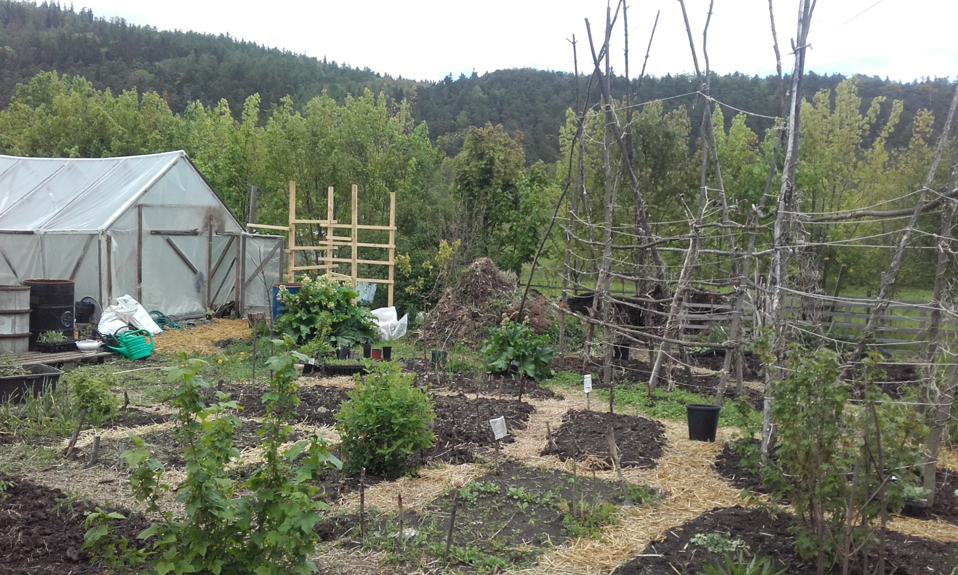
Photo: Farmyard Biostatek (CZ).
Author: Eliška Hudcová

Slide 27
LIST OF REFERENCES
Barker, R. L. (2003). The Social Work Dictionary. 5th Edition. Washington DC: National Association of Social Workers, ISBN 0-87101-355-X.
Berget, B., Lidfors, L., P´alsd´ottir, A. M., Soini, S., & Thodberg, K. (2012). Green Care in the Nordic countries—a research field in progress: Report from the Nordic Research Workshop on Green Care in Trondheim, June 2012. HealthUMB, Norwegian University of Life Sciences
Bronfenbrenner, U. (1977). Toward an experimental ecology of human development. American psychologist, 32(7), 513.
Bronfenbrenner, U. (1979). The Ecology of Human Development: Emperiments by Nature and Design. Cambridge, MA: Harvard University Press.
Cutcliffe, J.R. & Travale, R. (2016). „Unearthing the Theoretical Underpinnings of “Green Care” in Mental Health and Substance Misuse Care: Theoretical Underpinnings and Contemporary Clinical Examples“, Issues in Mental Health Nursing, 37:3, 137-147, DOI: 10.3109/01612840.2015.1119220
Emerson, R. W. (1950). The Complete Essays and Other Writings of Ralph Waldo Emerson (B. Atkinson, Ed.). Random House.
Lieberman, M. (2013). Social: Why our brains are wired to connect. NewYork, NY: Crown.
Marcel, G. G. (1948). In Blackham, H. J. (1986) Six existentialist thinkers (pp. 140–159). London, UK: Routledge.
Orbach, I. (2003). Suicide and the suicidal body. Suicide and Life-Threatening Behavior, 33(1), 1–8.
Orians, G. & Heerwagen, J.H. (1992). Evolved responses to landscapes. In: J.H. Barlow, L. Cosmides & J. Tooby, (Eds), The Adapted Mind, Evolutionary Psychology and the Generation of Culture. Oxford University Press.

Slide 28
LIST OF REFERENCES
Pokorná A., Sukupová M. (2014). NaomiFeil ® validation in geriatric care. Kontakt 16(2): e71–e78. http://dx.doi.org/10.1016/j.kontakt.2014.05.004
Pretty, J. (2004). How nature contributes to mental and physical health. Spirituality and Health International, 5, 68–78.
Procházková, P. 2012. Metoda validace – podpora práce s dezorientovanými lidmi. PROHUMAN. Online. cit. 05-22-22. Available at: https://www.prohuman.sk/socialna-praca/metoda-validace-podpora-prace-s-dezorientovanymi-lidmi
Proshansky, H. Fabian, A.K., Kaminoff, R.D. (1983) „Place-identity: Physical world socialization of the self. Journal of Environmental Psychology (3), 57-83), DOI:10.1016/S0272-4944(83)80021-8
Rosenberg, M.B. (2012). Living Nonviolent Communication: Practical Tools to Connect and Communicate Skilfully in Every Situation. Sounds True, Inc.
Sempik, J. (2010). Green care and mental health: Gardening and farming as health and social care. Mental Health and Social Inclusion, 14(3), 15–22.
Ulrich, R.S. (1983). Aesthetic and affective response to natural environment. In: I. Altman & J.F. Wohlwill, Behavior and the Natural Environment, Plenum Press, New York.
Wilson, E. O. (1984). Biophilia: The human bond with other species. Cambridge MA: Harvard University Press.

Slide 29
THANK YOU FOR YOUR ATTENTION
Name of Lecturer
Institution of Lecturer
name@xyz.com

Slide 30
Farming with Refugees and forced displaced people - Agriculture as a path of inclusion © 2022 by SoFarTEAM is licensed under CC BY-NC 4.0.
To view a copy of this license, visit http://creativecommons.org/licenses/by-nc/4.0/
The slides were created by Eliška Hudcová and Michal Pařízek
Contact:
Jabok - Academy of Social Pedagogy and Theology
Salmovská 8
120 00 Praha 2, Czech Republic
hudcova@jabok.cz, parizek@jabok.cz

